Slide 1
GEARS
🚗🏎🚜🚲🚛

Slide 2
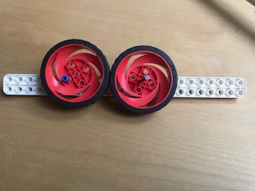

Slide 3
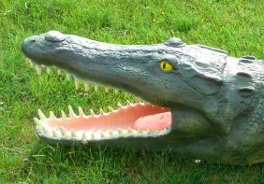
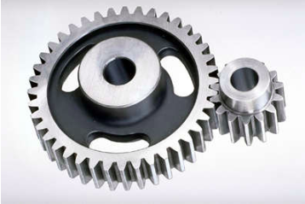
The power is in the teeth

Slide 4
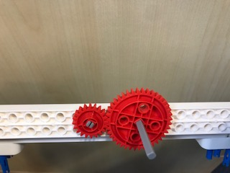
Direction shift 1 (Gear train)

Slide 5
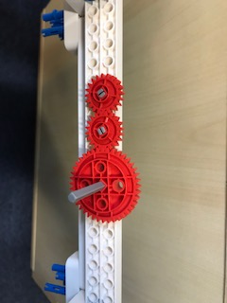
Direction shift 2 (Gear train)

Slide 6


